Slide 1
Jesus, The Son Of God
Matthew 16:13-18

Slide 2
Matthew 16:13-16, “Now when Jesus came into the parts of Caesarea Philippi, he asked his disciples, saying, Who do men say that the Son of man is? And they said, Some (say) John the Baptist; some, Elijah; and others, Jeremiah, or one of the prophets. He saith unto them, But who say ye that I am? And Simon Peter answered and said, Thou art the Christ, the Son of the living God.”

Slide 3
The Prophecy He Fulfilled
The Gospel of Matthew, presents Jesus as the Messiah, in fulfillment of Old Testament prophecy (1:1, 17, 22-23).
1. He is Immanuel – “God with us” (1:23), exercising power over disease (4:24), the forces of nature (8:18-27), and even death (9:18-26).
2. He is crowned as King on the throne of David (1:17), coming triumphantly to his capital (21:1-11), having been exalted above the Law and the Prophets (17:1-5).
3. He inaugurated the New Covenant by His own blood (26:28), establishing Himself as mankind’s High Priest (27:51), reigning as King with “all authority” both “in heaven and on earth” (28:18).

Slide 4
The Prophecy He Fulfilled
The Messiah would be born of a virgin
(Isaiah 7:14; fulfilled in Matthew 1:22-23)
The Messiah would be born in Bethlehem
(Micah 5:2; fulfilled in Matthew 2:5-6)
The Messiah would be “called out of Egypt”
(Hosea 11:1; fulfilled in Matthew 2:15)
The massacre of innocent male children
(Jeremiah 31:15; fulfilled in Matthew 2:16-18)
The Messiah would be preceded by a messenger
(Isaiah 40:3; fulfilled in Matthew 3:3)
The Messiah’s work would begin in Galilee
(Isaiah 9:1-2; fulfilled in Matthew 4:12-16)

Slide 5
The Prophecy He Fulfilled
The Messiah would take “our infirmities”
(Isaiah 53:4; fulfilled in Matthew 8:17)
The Messiah would teach by parables
(Psalms 78:2; fulfilled in Matthew 13:34-35)
The Messiah would enter Jerusalem on a donkey (Zechariah 9:9; fulfilled in Matthew 21:1-10)
The Messiah would be sold for 30 pieces of silver (Zechariah 11:12; fulfilled in Matthew 27:9)
Lots would be cast for the Messiah’s clothing
(Psalms 22:18; fulfilled in Matthew 27:35)

Slide 6
16 Prophecies He Fulfilled In 24 hours
1. Sold for 30 pieces of silver. Zechariah 11:12;
Matthew 26:14,15.
2. The money to be cast to the potter. Zechariah 11:13; Matthew 27:3-10.
3. His disciples to forsake him. Zechariah 13:7; Matthew 26:56; Mark 14:27.
4. He was silent before His accusers. Isaiah 53:7;
Matthew 27:12-14.
5. He was wounded and bruised. Isaiah 53:7;
Matthew 27:12-14
6. His hands and feet to be pierced. Psalms 22:16;
John 20:25-27.
7. He was to be crucified with thieves. Isaiah 53:12;
Mark 27:41, 43
8. He was to pray for His persecutors. Isaiah 53:12; Luke 23:34

Slide 7
16 Prophecies He Fulfilled In 24 hours
9. The people were to shake their heads at the crucified one.
Psalms 22:7; Matthew 27:39
10. The people were to ridicule Him. Psalms 22:7,8; Matthew 27:41-43
11. The people were to be astonished. Psalms 22:17; Isaiah 52:14;
Luke 23:35.
12. His garments to be parted and lots cast. Psalms 22:18; John 19:24.
13. He was to cry “My God, My God, Why hast thou forsaken me?”
Psalms 22:1; Matthew 27:46.
14. His bones were not to be broken. Psalms 34:20; John 19:33, 36.
a. Jews used stoning for execution. This would break bones.
b. Crucifixion was not used at the time of the prophecy (Time of David: ca. 1,000 BC). The Persians introduced crucifixion 550 BC.
15. His side to be pierced. Zechariah 12:10; John 19:34,37.
16. He was to be buried in a rich man’s tomb. Isaiah 53:9; Matthew 27:57-60

Slide 8
The Testimony Of John
“And I knew him not: but he that sent me to baptize in water, he said unto me, Upon whomsoever thou shalt see the Spirit descending, and abiding upon him, the same is he that baptizeth in the Holy Spirit. And I have seen, and have borne witness that this is the Son of God.” John 1:33-34
Jesus told the Jews, “Ye have sent unto John, and he hath borne witness unto the truth.” John 5:33

Slide 9
The Miracles He Performed
Matthew 4:23-25, “And Jesus went about in all Galilee, teaching in their synagogues, and preaching the gospel of the kingdom, and healing all manner of disease and all manner of sickness among the people. And the report of him went forth into all Syria: and they brought unto him all that were sick, holden with divers diseases and torments, possessed with demons, and epileptic, and palsied; and he healed them. And there followed him great multitudes from Galilee and Decapolis and Jerusalem and Judaea and (from) beyond the Jordan.”

Slide 10
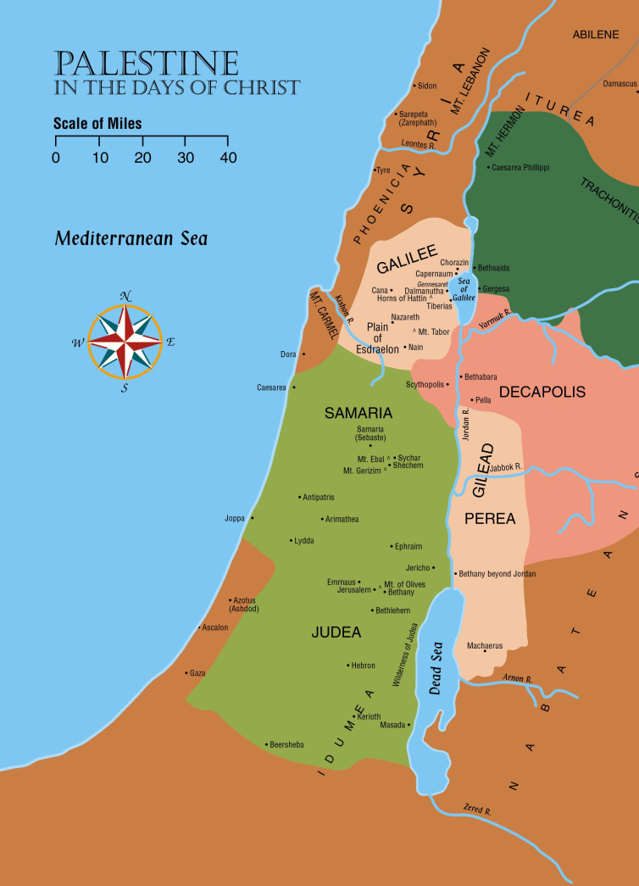
The Miracles He Performed
Fame spread and crowds came from all over!
cf. Matthew 4:24-25; Mark 3:7-8
  Syria, Galilee, Decapolis, Jerusalem, Judea, Idumaea, and beyond Jordan, Tyre, Sidon.
  240 Towns.
  Jesus said His miracles were a greater witness to His Divinity than John himself (John 5:31-36).
Jesus had compassion on them
  Was teaching lessons they had never heard before.
  cf. Matthew 7:29

Slide 11
The Testimony Of The Father
Baptism of Jesus. Matthew 3:16-17
Transfiguration. Matthew 17:5
NOTE: 2 Peter 1:16-18, “For we did not follow cunningly devised fables, when we made known unto you the power and coming of our Lord Jesus Christ, but we were eyewitnesses of his majesty. For he received from God the Father honor and glory, when there was borne such a voice to him by the Majestic Glory, This is my beloved Son, in whom I am well pleased: and this voice we (ourselves) heard borne out of heaven, when we were with him in the holy mount.”

Slide 12
The Resurrection
The apostle Paul opens the Roman letter by pointing to Jesus Christ our Lord, “who was born of the seed of David according to the flesh, who was declared (to be) the Son of God with power, according to the spirit of holiness, by the resurrection from the dead” –
Romans 1:1-4
The foundation of the gospel rests on the Lord’s resurrection from the grave. 1 Corinthians 15:3-4;
cf. 15:12-19

Slide 13
Conclusion
Hebrews 1:1-3, “God, having of old time spoken unto the fathers in the prophets by divers portions and in divers manners, hath at the end of these days spoken unto us in (his) Son, whom he appointed heir of all things, through whom also he made the worlds; who being the effulgence of his glory, and the very image of his substance, and upholding all things by the word of his power, when he had made purification of sins, sat down on the right hand of the Majesty on high.”
Hebrews 2:2-3, “For if the word spoken through angels proved stedfast, and every transgression and disobedience received a just recompense of reward; how shall we escape, if we neglect so great a salvation? which having at the first been spoken through the Lord, was confirmed unto us by them that heard”

